Slide 1

We The Students Of Project Group no:- 4
WELCOMES
All Faculty of our Department for the Presentation on the project
“Home Automation System”
Department of Computer Technology SDMP,Nagpur

Slide 2
Project Title
Project Title: Home Automation System Using Node_MCU
Name of Students: 1.Amaan Ranapurwala
2.Aniruddha Kate
3.Dewam Katole
4.Ritvik Nimje
Name of Guide: Mr. S.Taley
Session: 2019-2020
Department of Computer Technology SDMP,Nagpur

Slide 3
Outline
Project Introduction
Objective of the Project
Flow Chart / Circuit Diagram
  Preferred Technologies
  Screenshot
  Scope (End User of your project)
  Advantages
  Conclusion
Achievements
References

Slide 4
  Project Introduction
Today in the headway of Automation innovation, life is getting simpler and less demanding in all spheres. Home automation is a modern technology that modifies your home to perform different sets of tasks automatically. Today Automatic frameworks are being favored over manual frameworks. The first and most obvious advantage of Smart Homes is comfort and convenience, as more gadgets can deal with more operations (lighting, temperature, and so on) which in turn frees up the resident to perform other tasks. Home automation is an appealing context for the Internet of Things (IoT), by connecting the IP gateway directly to the Internet or through a home/residential gateway; this system can be managed remotely using a PC, Smart phone, Tablet or other devices.
Department of Computer Technology SDMP,Nagpur

Slide 5
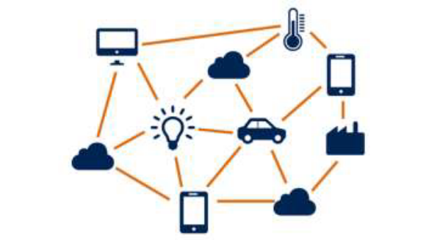
Objective of the Project
We can turn on/off lights and fans from anywhere in the world.
The AC/Cooler can automatically turn itself on/off according to temperature we have set.
When the natural lights gets low , the sensor will automatically detect the change in light and will turn on light appliance.
Department of Computer Technology SDMP,Nagpur

Slide 6
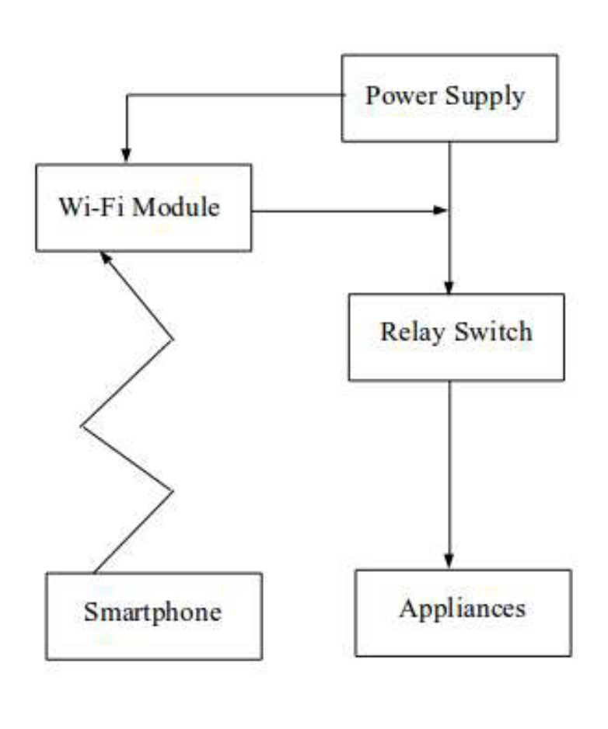
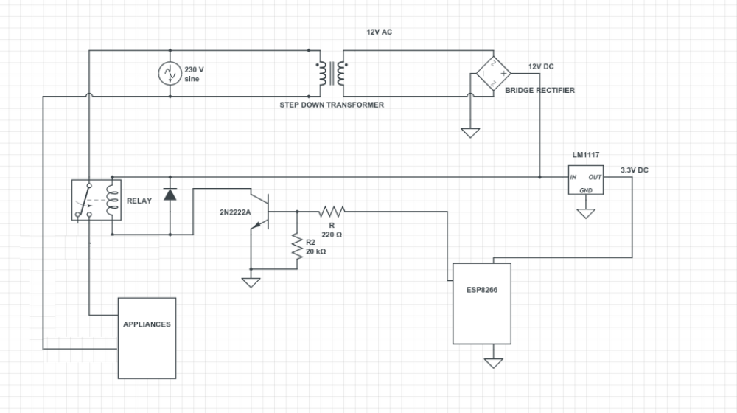
Flow Chart / Circuit Diagrams
Department of Computer Technology SDMP,Nagpur

Slide 7
    Preferred Technologies
    Preferred Technologies
      Operating System - Windows 10
      Software Requirement :-
      Front End - Blynk App
      Back End - Arduino Software
      Hardware Requirements - Working Wi-Fi
Department of Computer Technology SDMP,Nagpur

Slide 8
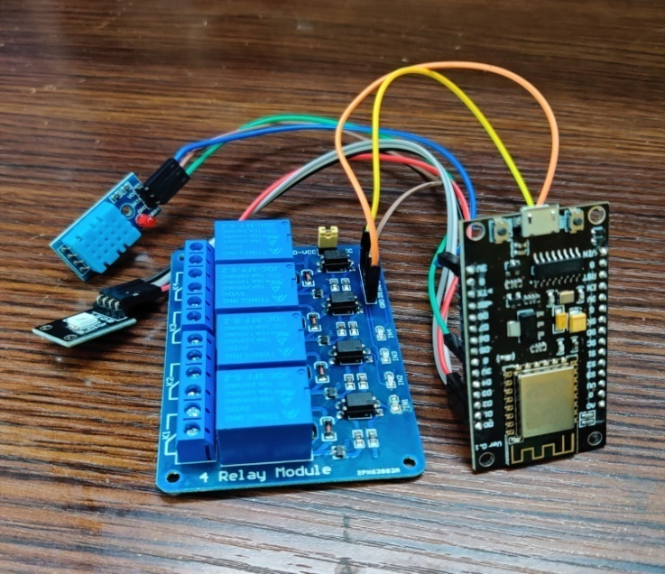
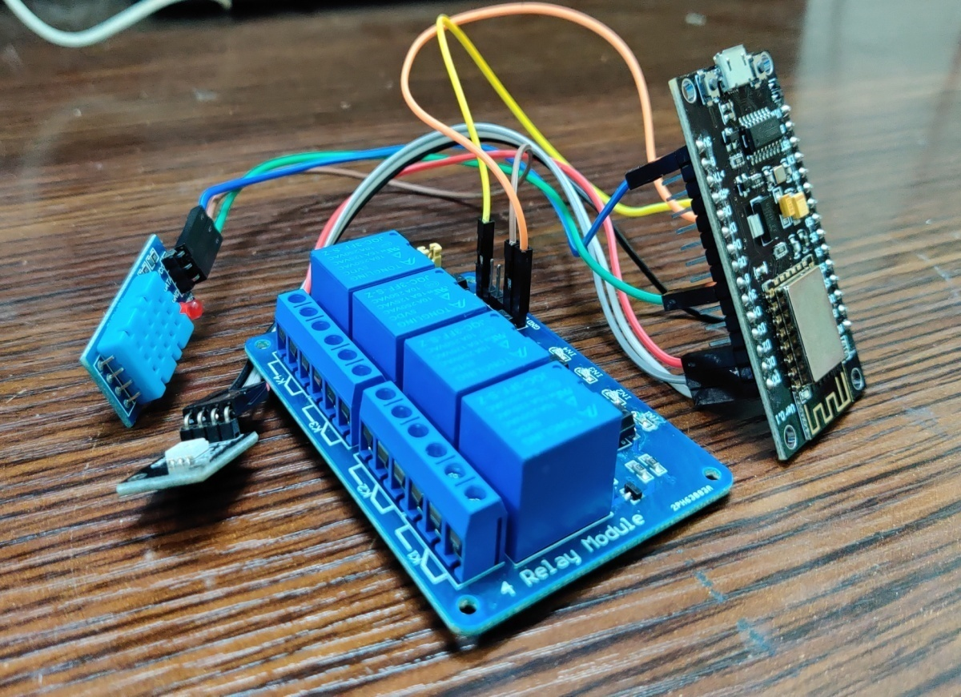
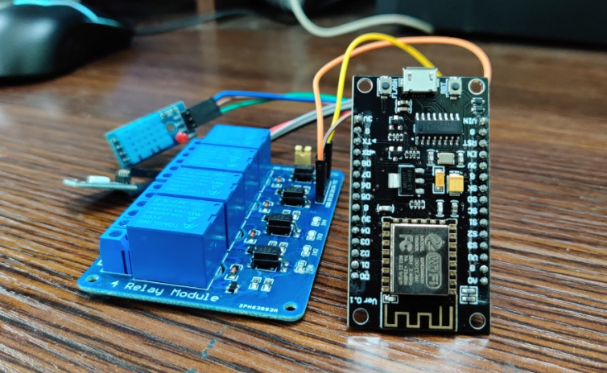
Screenshots
Figures Of Working Model

Slide 9
Scope (End User of your project)
In real time web based home automation system this project can be extended in future to ensure the high security, the motion and vibration can be monitored through online via HD spy camera. With this, the system can be incorporated in a whole building of any institution or residential building and can monitor from anywhere. This way, advantages of home automation can be more availed.
Department of Computer Technology SDMP,Nagpur

Slide 10
Advantages
Saves electricity.
Control home appliances form anywhere in the world.
Quick response.
You will receive a email or SMS for any activity.
Helps for safety purpose.
Monitoring 24/7.
Department of Computer Technology SDMP,Nagpur

Slide 11
Conclusion
Hence we have successfully developed home automation system using the connection between Bylnk app and Node_MCU.
The database is developed in such a way that can be accessed from any sort of device that supports internet from anywhere in the world.
Department of Computer Technology SDMP,Nagpur

Slide 12
Achievements
S.N | NAME OF STUDENTS | PARTICIPATION IN PROJECT COMPETITION /PAPER PRESENTATION
1. | Amaan Ranapurwala Aniruddha Kate Dewam Katole Ritvik Nimje | 1st Prize at TECHNOFEST-2020, ORGANISED BY TULSIRAMJI GAIKWAD-PATIL, 22/02/20
2. | Amaan Ranapurwala Aniruddha Kate Dewam Katole Ritvik Nimje | TECHNOFEST-2020, ORGANISED BY TULSIRAMJI GAIKWAD-PATIL, 22/02/20, PARTICIPANT

Slide 13
References
  Book & E-book :-
  Learning internet of things by peter warner
  Arduino FAQ With David Cuartielles
  Website or links :-
  https://www.google.com
  https://www.youtube.com
  https://www.coursera.org
  https://en.wikipedia.org/wiki/Electronic_component
Department of Computer Technology SDMP,Nagpur

Slide 14

Department of Computer Technology SDMP,Nagpur

